Slide 1

AI-Based Sign Language to Text Conversion System
By
Ihtisham Khan (2230-0157)
Muhammad Anas (2230-0091)
Muhammad Danish Nasir (2230-0126)
Supervisor: Hamid Ashfaq
Co-Supervisor: Abdur Rehman

Slide 2
INTRODUCTION
Lack of real-time automated sign language interpretation systems
Existing solutions are limited in accuracy and accessibility
Need for a reliable, cost-effective, and user-friendly AI system
Proposed system converts sign gestures into text and speech

Slide 3
PROBLEM STATMENT
Sign language is the primary communication method for hearing-impaired people
Communication gap between signers and non-signers
Manual interpretation is not always available
This project proposes an AI-based solution for automatic sign-to-text conversion

Slide 4
OBJECTIVES
Recognize sign language gestures using AI
Convert recognized signs into text and speech
Real-time prediction using camera
Build user-friendly mobile interface

Slide 5
INITIAL DATASET PROBLEM
Original dataset contained only 25–30 images per class
Model could not learn discriminative features
Low accuracy and incorrect predictions
Needed a better data representation approach

Slide 6
SYSTEM OVERVIEW
System Modules:
AI Module: Landmark extraction, Sign recognition, Sentence formation
UI Module: Camera input, Live prediction display, Text and speech output

Slide 7
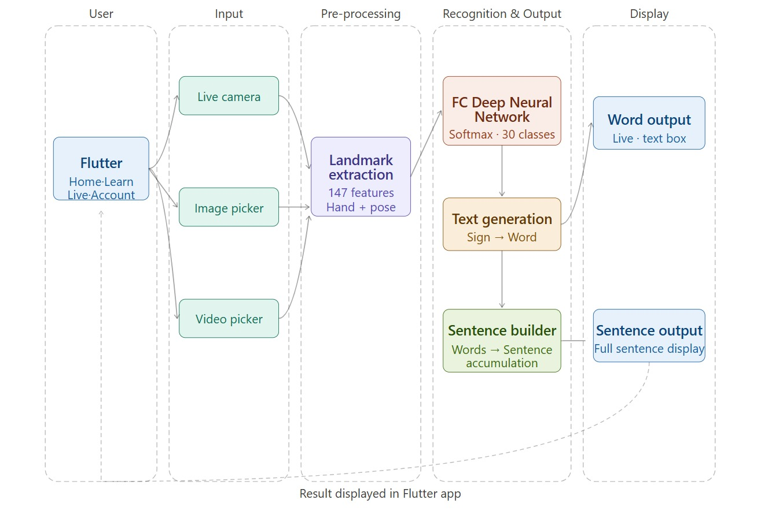
MAIN SYSTEM ARCHITECTURE

Slide 8
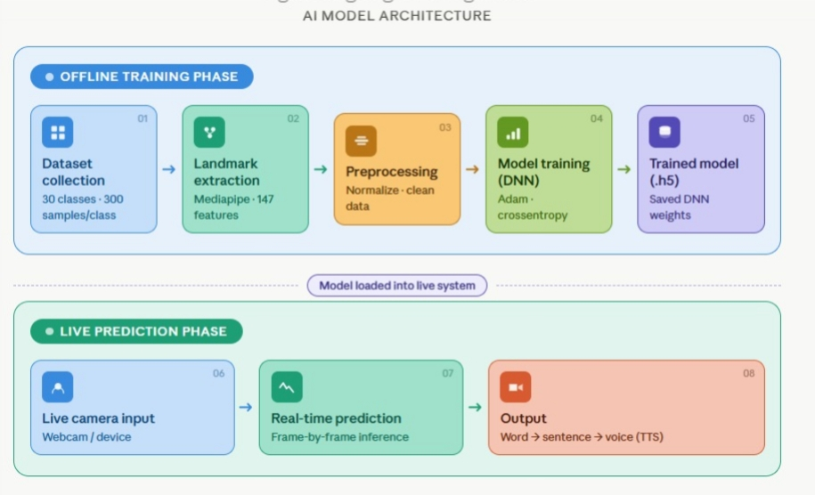
AI MODEL ARCHITECTURE
Input Layer: 147 features
Dense(256) + ReLU + Dropout(0.4)
Dense(128) + ReLU + Dropout(0.3)
Dense(64) + ReLU
Output: Softmax (30 Classes)
Loss: Categorical Cross-Entropy
Optimizer: Adam
Early Stopping to prevent overfitting

Slide 9
DATASET DESCRIPTION
Custom dataset collected using mobile and laptop camera
30 sign classes
300 samples per class
Each sample stored as 147 normalized landmark values
Dataset balanced to avoid bias

Slide 10
DATA PROCESSING
Extract landmarks using Mediapipe (hands + pose)
Normalize landmark coordinates
Remove incomplete/noisy frames
Save features as .npy files
No image resizing or CNN preprocessing

Slide 11
DATASET SPLIT
Training: 80%
Testing: 20%
Stratified split to maintain class balance

Slide 12
TRAINING PROCESS
Model: Fully Connected Neural Network
Batch Size: 32
Optimizer: Adam
Loss: Categorical Cross-Entropy
EarlyStopping with patience=5
Validation monitored during training

Slide 13
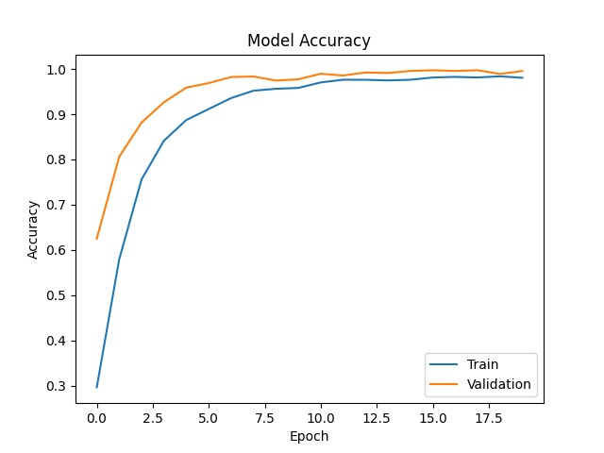
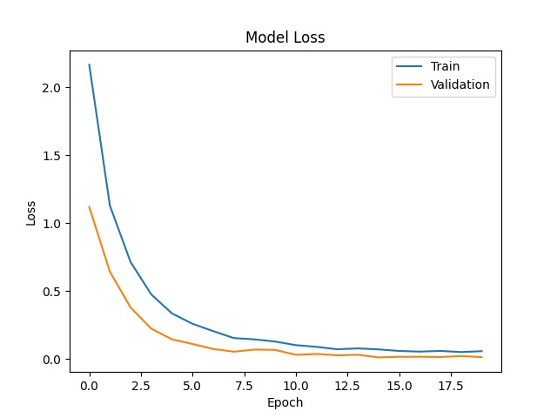
MODEL PERFORMANCE EVALUTION

Slide 14
Real-Time Recognition Workflow
Camera captures frame
Mediapipe extracts landmarks
147 features fed to trained model
Model predicts gesture
Sentence builder + grammar correction
Text-to-speech output

Slide 15
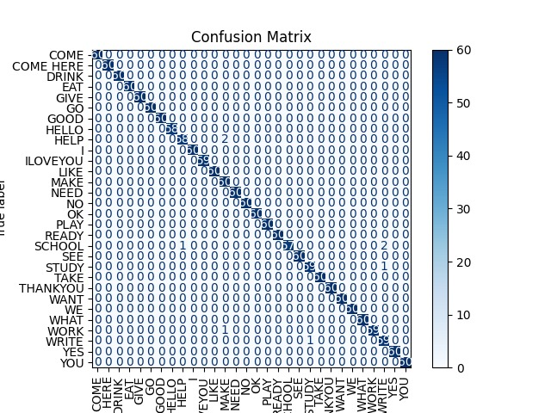
CONFUSION MATRIX ANALYSIS

Slide 16
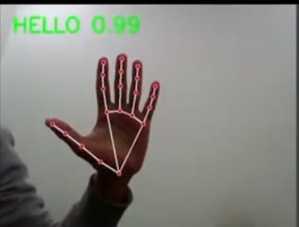
RESULT AND DEMONSTRATION
Real-time sign recognition working
Sentence formation from continuous signs
Audio output of recognized words
Stable performance under normal lighting

Slide 17
UI MODEL OVERVIEW
UI developed independently using Flutter
Screens included:
Splash & Authentication
Home Dashboard
Live Camera Screen (UI only)
Image Upload Screen
Learning Module
UI focuses on usability and smooth navigation

Slide 18
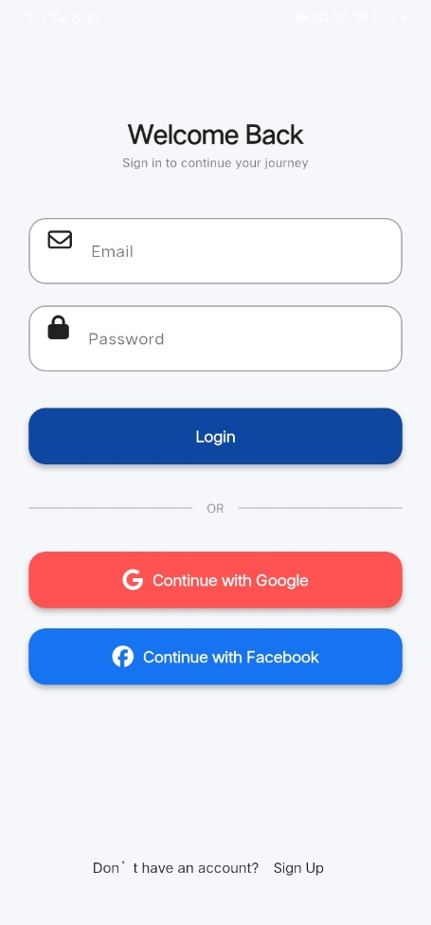
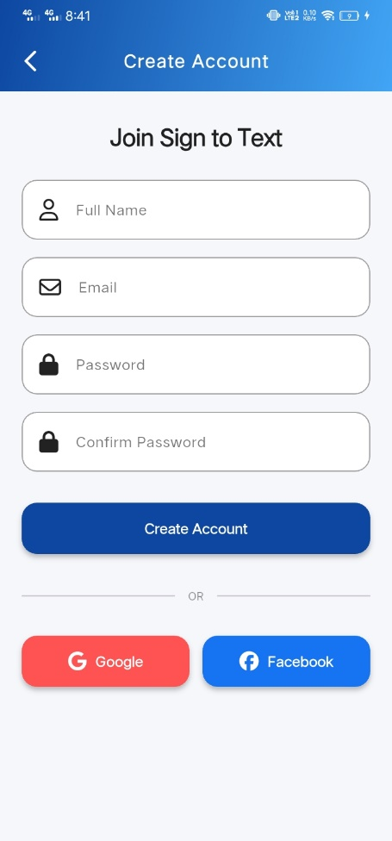
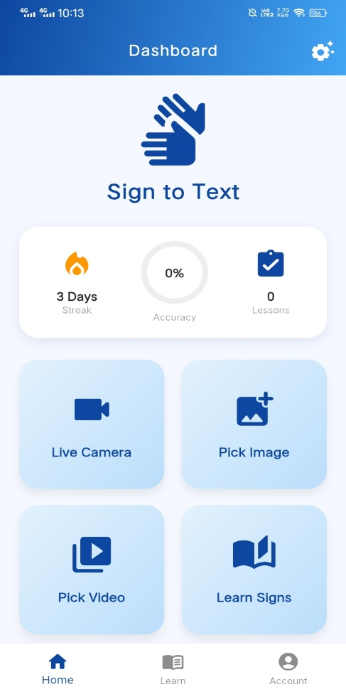
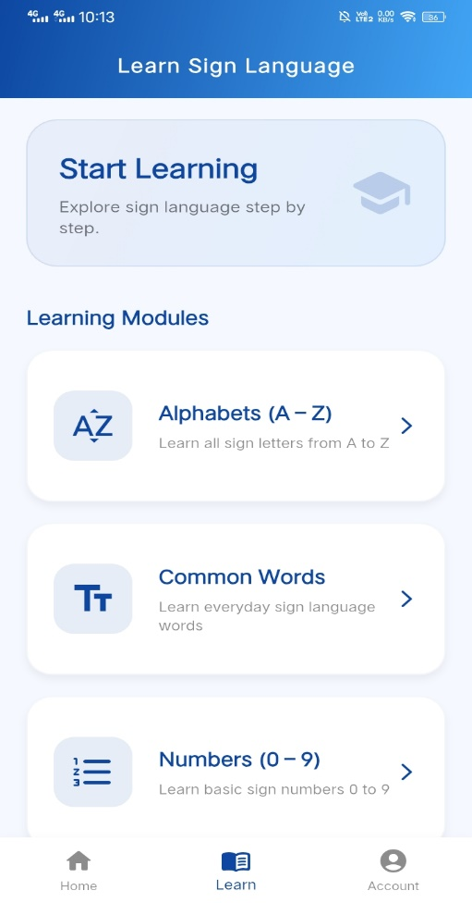
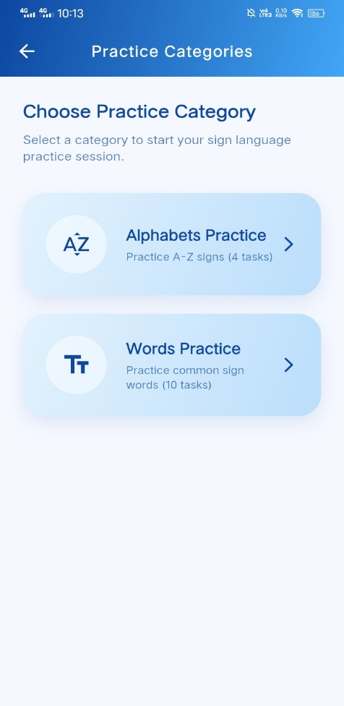
UI MODEL OVERVIEW

Slide 19
CHALLENGES FACED
Similar hand shapes caused confusion
Lighting variations affect landmark detection
Real-time stability issues

Slide 20
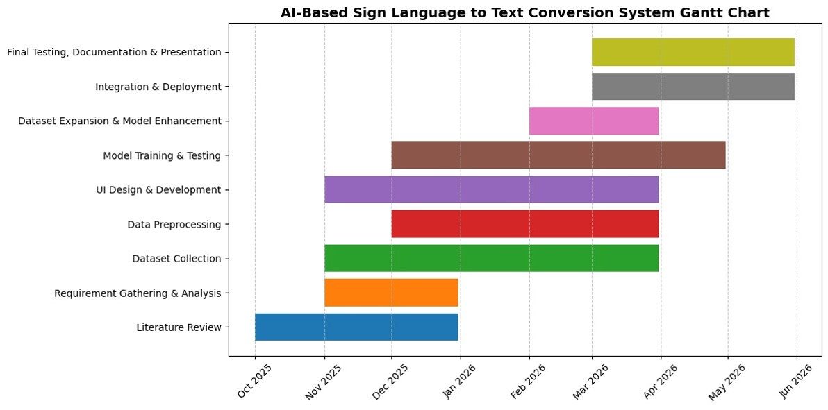
PROJECT TIMELINE (Gantt Chart)

Slide 21
CONCLUSION
Successfully developed an AI-based sign language recognition model
Designed a separate mobile UI for sign-to-text application
AI model and UI were tested independently
Project demonstrates feasibility of AI-driven sign language recognition

Slide 22
FUTURE ENHANCEMENTS
Increase dataset size for better accuracy
Improve model performance and robustness
Support more sign language gestures
Optional text-to-speech output
Full integration of AI model with UI

Slide 23
Thank You For Your Attention

